Slide 1
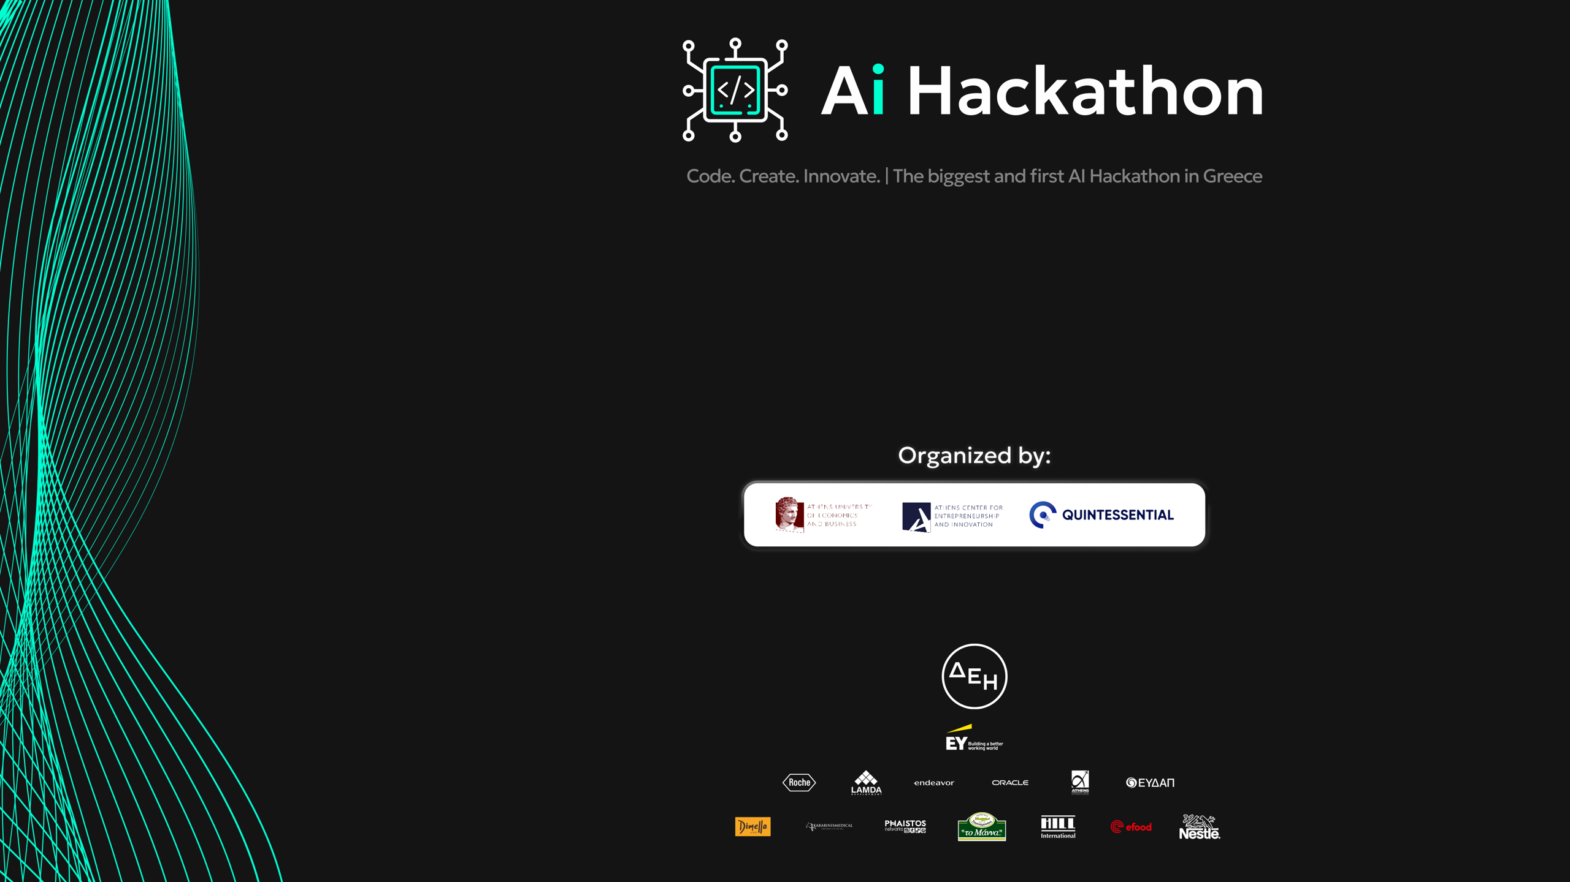
Explainomatic

Slide 2


Introduction
Special Challenge: “Students' dropout and academic success prediction “
By two participants with experience in the field of education

Slide 3

Solution Overview
Developed a decision support system based on boosting learning algorithms.
Use of explainable AI to ensure the transparency of our system and our alignment with the EU AI act.
We managed to achieve higher accuracy than the bibliography
.
Not simply identify at-risk students, but also unlock actionable insights from our dataset features.

Slide 4
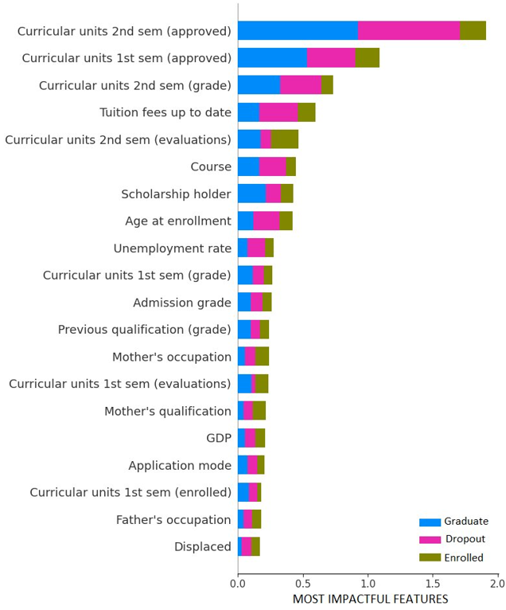
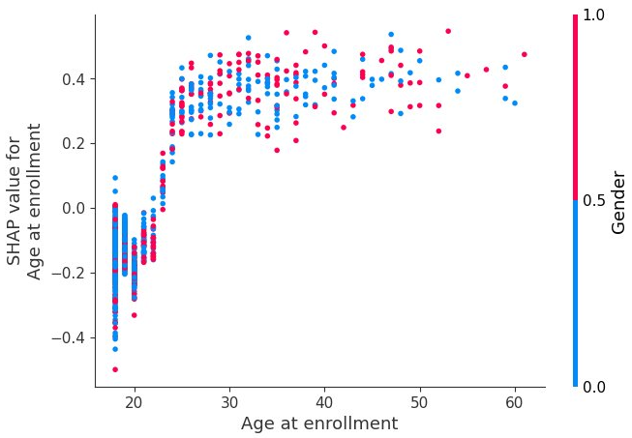
Demo/Use Case

Slide 5
Results and Impact
Help guide the decision strategy of stakeholders and improve KPIs
For instance, based on our system's results, we can see that dropout is mainly affected by performance metrics rather than their previous performance.
Lastly, important factors include the economic status of the student, i.e. if they have covered their tuition fees, or if they hold a scholarship and the economic status of the country.

Slide 6
Future Enhancements
Our solution is only the beginning. We envision a future where AI-powered student success tools continue to evolve and expand:
Incorporating richer data sources
Integration with learning platforms (MOOCs)
Ensure fairness and protect against any potential biases against marginalized groups of the classification system

Slide 7


The Team
.
Tsakoumis Dimitrios, PhD Candidate, UNIPI
Kalampalikis Nektarios, Data Scientist, EY

Slide 8

Thank you for your time and concentration.

